Slide 1
Image caption generation with Keras

Slide 2
Why image caption generation?
Image caption generation is the process,
Given an images, generate a phrase/sentence that best describes the image
Done by,
Getting an image embedding from a pretrained-CNN
Using this as the first input to an LSTM
Train the LSTM by projecting words in the caption to the same embedding space and predicting the next word
Applications
Image-based web search
Automatic image captioning for social media

Slide 3
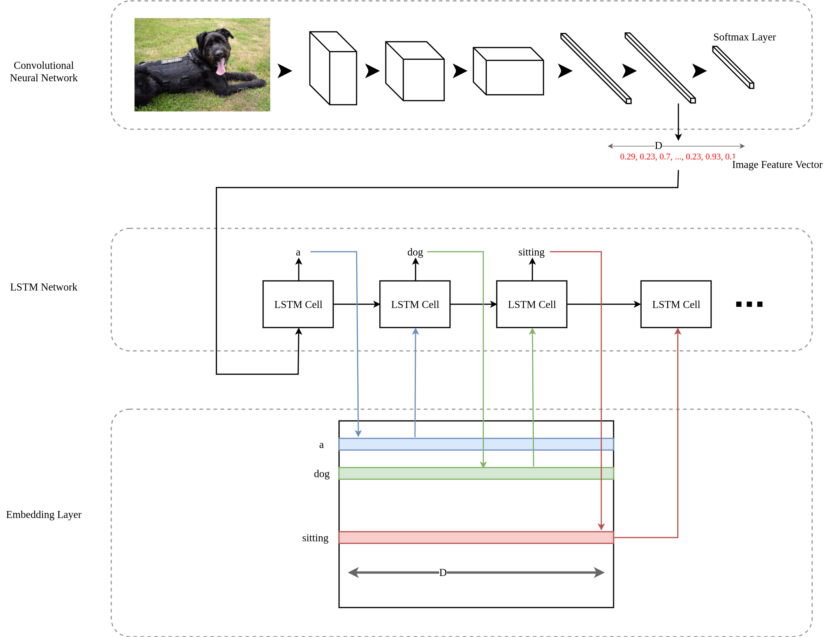
Overview of an image caption generator
More info: Refer chapter 9 of “Natural language processing with TensorFlow”

Slide 4
Challenges in image caption generation
Model complexity
Often require large pretrained CNNs and LSTM network
Difficult to debug
Bias created by limited amount of data
Man in traditional clothing in Asia might be recognized as wearing a suit

Slide 5
Implementing an Image Caption Generator

Slide 6
Introduction to data
Source: http://vision.cs.uiuc.edu/pascal-sentences/
Dataset scraper (Modified): https://github.com/rupy/PascalSentenceDataset/blob/master/pascal_sentence_dataset.py
Required packages:
Activate the tekbac.deeplearning virtual environment
Execute pip install pyquery
Create two folders “dataset” and “sentence” in your project dir

Slide 7
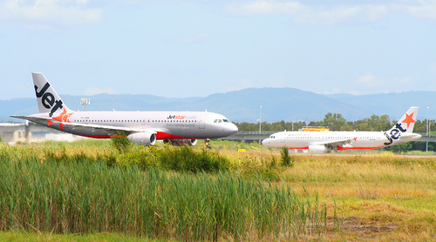
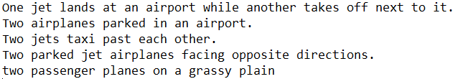
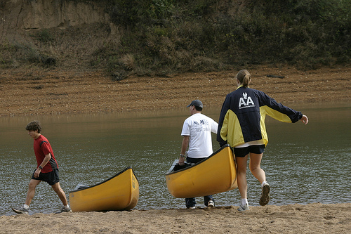
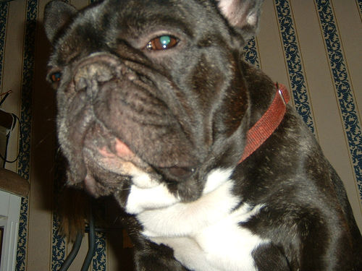
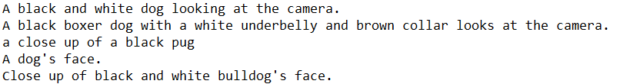
Introduction to data

Slide 8
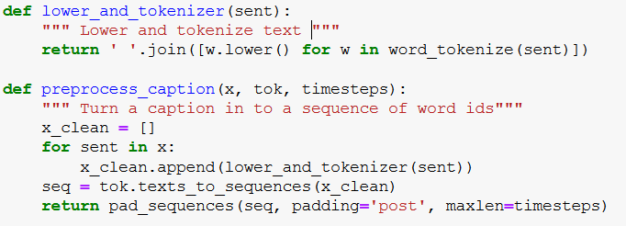
Preprocessing text
“A dog sitting” → Lower_and_tokenize → [“a”, “dog”, “sitting”]
“A dog sitting” → preprocess_caption → [1, 2, 3, 0, 0, 0]

Slide 9
Creating dataframes
Since we need to associate captions with images
We use pd.DataFrame objects
Following columns will be available
captions – Caption text
images – Filename of the image
captions_preproc – Preprocessed caption text
captions_length – Length of the caption text

Slide 10
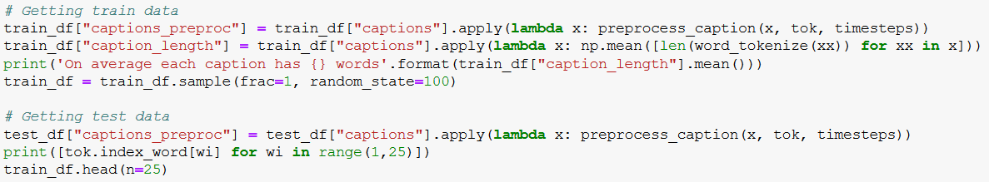
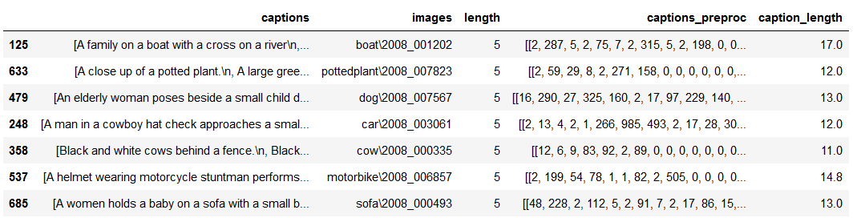
Creating dataframes

Slide 11

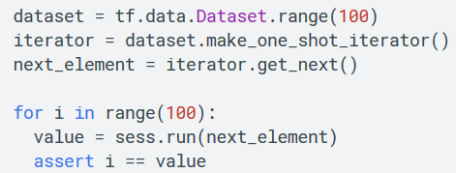
Introducing tf.Data API
More info: https://www.tensorflow.org/guide/datasets
Designed to build large input pipelines
If data cannot be loaded to the device fully (e.g ImageNet dataset)
Two ways to retrieve data
tf.data.Dataset.from_tensor_slices – data from a tensor object
tf.data.Iterator – Allows more complex manipulations

Slide 12

Dataset transformations
You can chain several different transformation to perform complex transformations

Slide 13
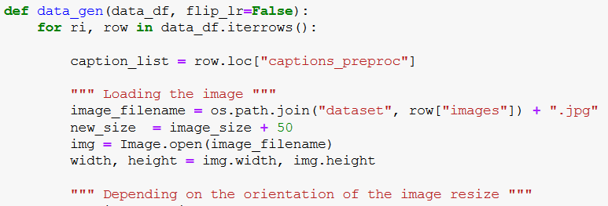
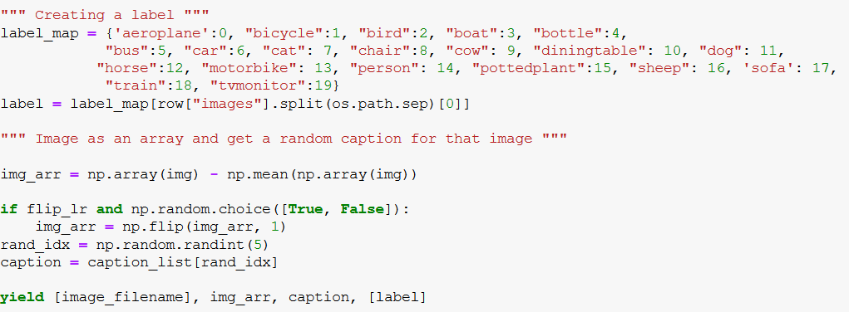
Defining a data generator
…

Slide 14
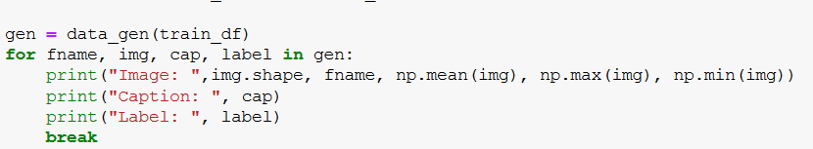
Running the data generator

Slide 15
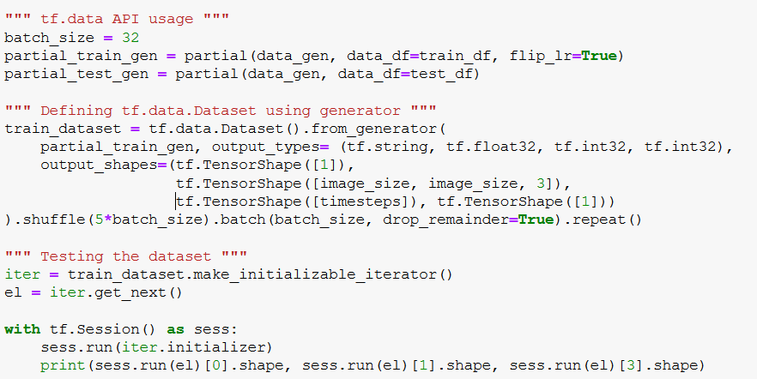
Using generator with tf.data API

Slide 16
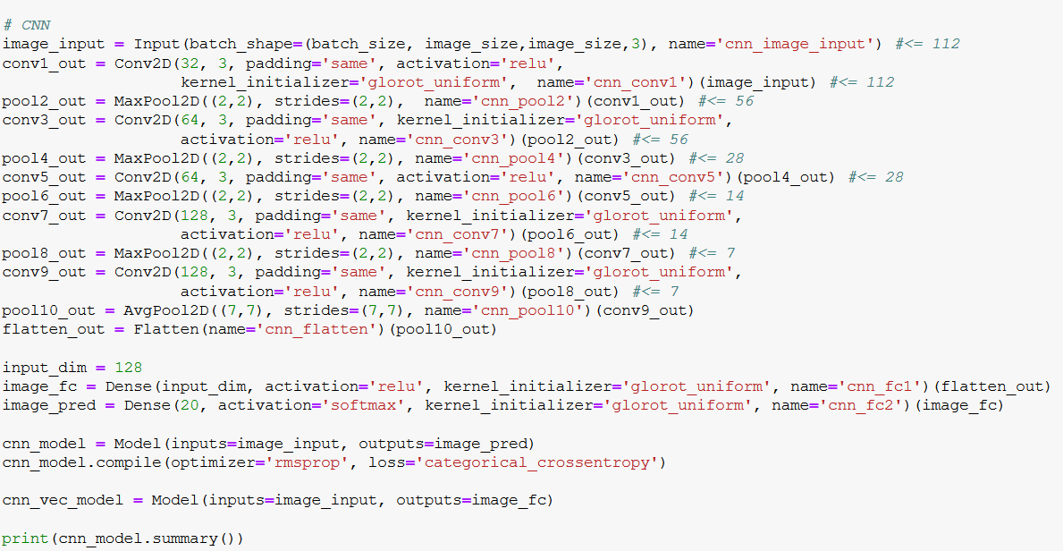
Defining the CNN

Slide 17
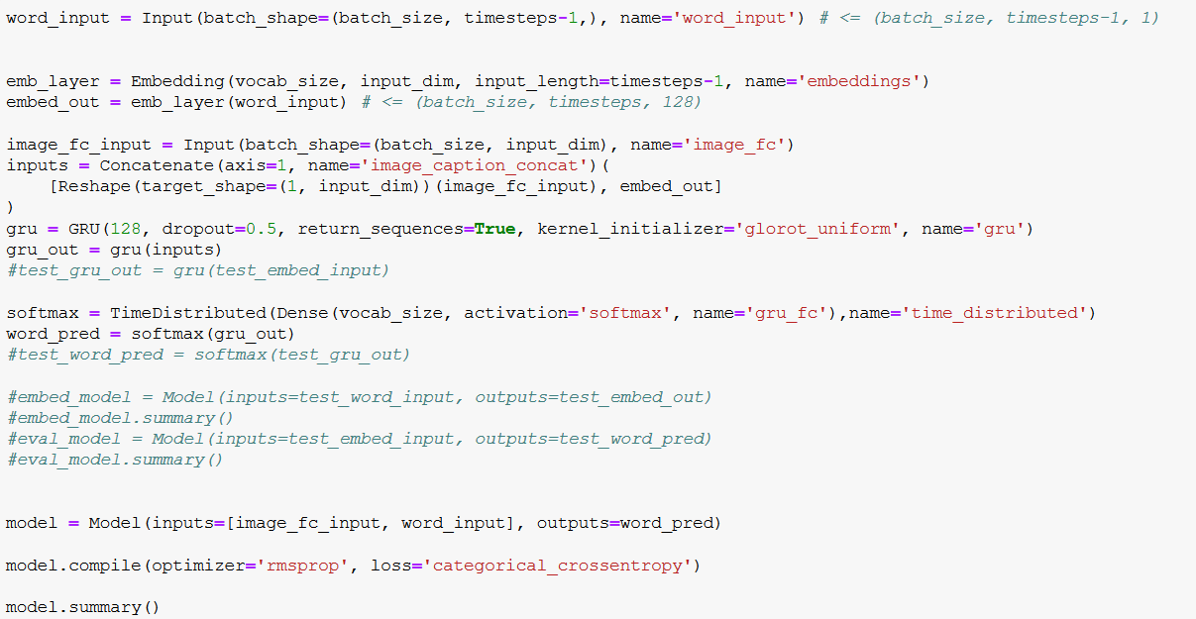
Defining the GRU network

Slide 18
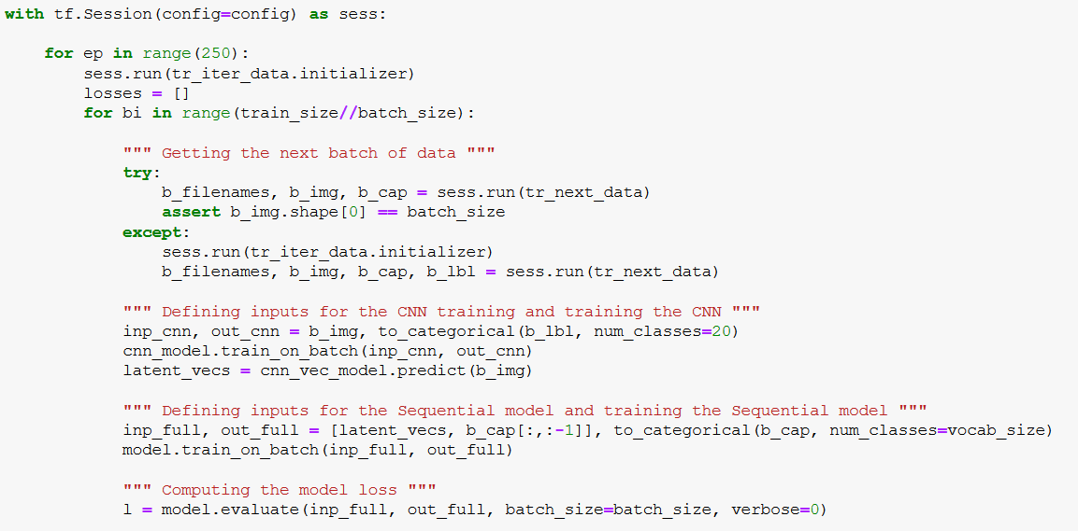
Running the caption generator

Slide 19
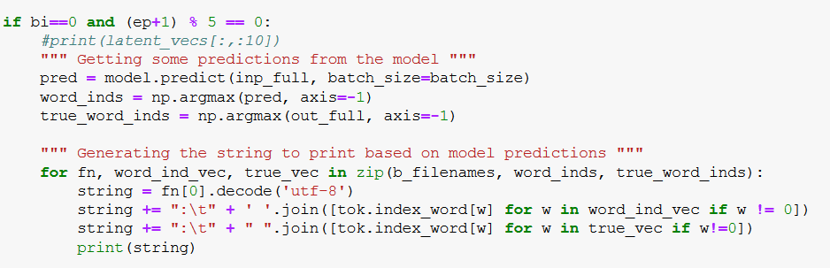
Printing out predictions

Slide 20
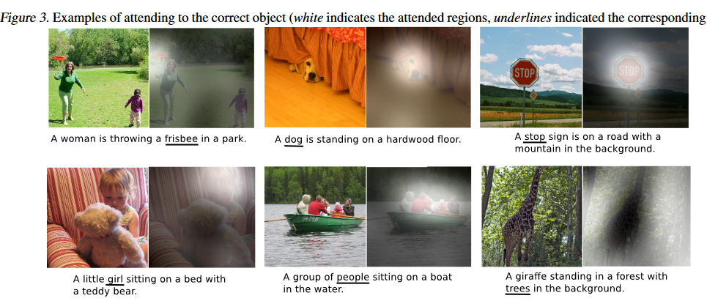
Improving further
CNN with attention
Show, Attend and Tell: https://arxiv.org/pdf/1502.03044.pdf
https://arxiv.org/pdf/1502.03044.pdf

Slide 21
Conclusion
Why image caption generation?
What are some applications?
Architecture of an image caption generator
tf.data API
Using tf.data API to generate data
Defining CNN/GRU network of an image caption generator
Running the image caption generator
Improvements

